Slide 1
Final Project (CSA)

Slide 2

Document scanner: Convert text from Image to text.
Sometimes, you have an image which contains text. You want to convert them from image to text because You are lazy to type it.
Another scenario when you have an old book, or just a screenshot, or hand-written text and you want to copy them as digital text.

Slide 3
Document scanner: Convert text from Image to text.
Such tool exist!
However, most of them are paid tools.
There also a free and open-source tool which is Tesseract-OCR.
Tesseract is very good at detecting the typed text, but it has a very bad user interface. It could overwhelm normal people because it is command line tool.

Slide 4
Document scanner: Convert text from Image to text.
There is also another limitation to Tesseract-OCR which is when you use image with a lot of different colors. It will overwhelm and produce wrong result.
So, we should convert our image to black and white color or grayscale it. We should crop and rotate the image to the right position before using Tesseract-OCR.
So, I set out to write a GUI program to overcome those limitation.

Slide 5
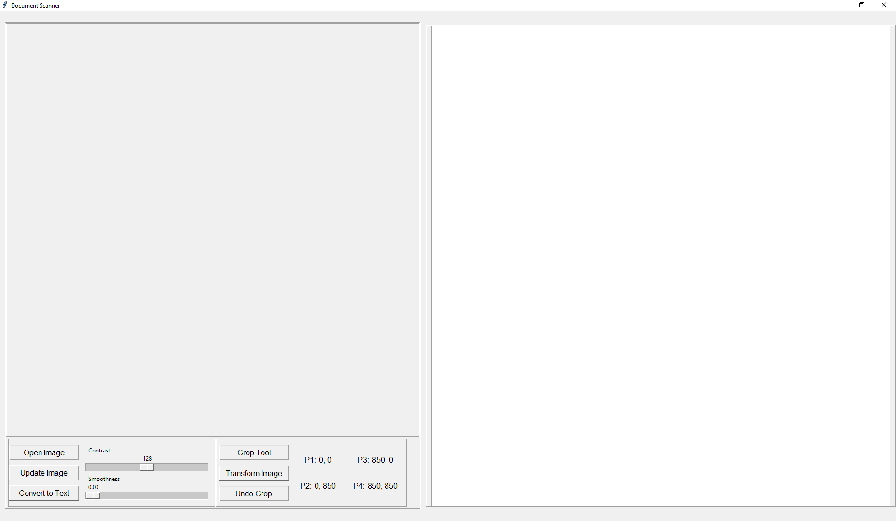
Document scanner: Convert text from Image to text.

Slide 6
Document scanner: Convert text from Image to text.
Algorithms and analysis will be present with code demo.

